Slide 1
Enhancing Long-Distance Running Performance Over Time
JaSai Kimsey
Eastern Michigan University

Slide 2
Topic
Throughout history, long-distance running has seen the arise of a excellence runner thought out the years.
In the modern era of distance running, marked by its evolving dynamics at the professional levels, has cause arise in elite running talent.
These excellence runner represent the best in the world, they are responsible for producing the top-performing long-distance runners. Between 1897 and 2019, they accounted for change for the professional marathon circuits.

Slide 3
Research Question and Hypothesis
Research Question:
Has winners of long-distance race performance improve over time?
Hypothesis:
If the long-distance racer winners is in more recent history, then they are more likely to exhibit faster race times.

Slide 4
Data Source
All racer that run in the Boston Marathon between 1897-2019.
All of the racers must have won the race to be include to this data.
This data is collected of the Boston Marathon Data Project which collect data above the marathon every year.

Slide 5
Introduction To The Methodology
Linear Regression
Linear regression is a statistical method used to model the relationship between a dependent variable and independent variables by fitting a straight line to the data points.
Distribution
Distribution refers to the way data values are spread displaying the probability of different values within a dataset.
Hypothesis Testing
Hypothesis testing is a statistical method used to determine whether there is a significant difference between groups, based on data and a predefined null hypothesis.

Slide 6
Independent Variable
The winner's time in seconds to complete the race measure and the year where the event the race took place is an independent variable in this research proposal.
While the dependent variable is the location of the race, the age group of the race, and the path that the runner ran on.

Slide 7
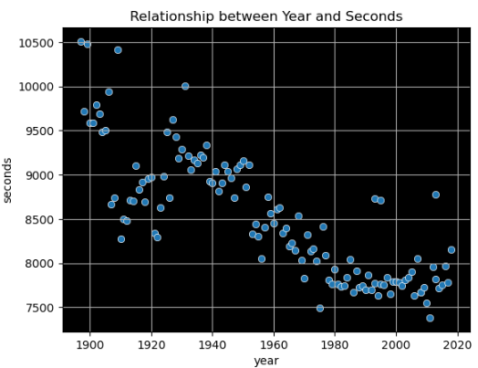
Scatter plot
Distribution: Finishing time are in a descending order
Majority of finishing time are below 9000 seconds

Slide 8
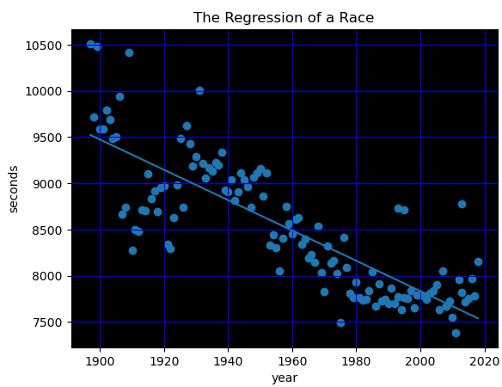
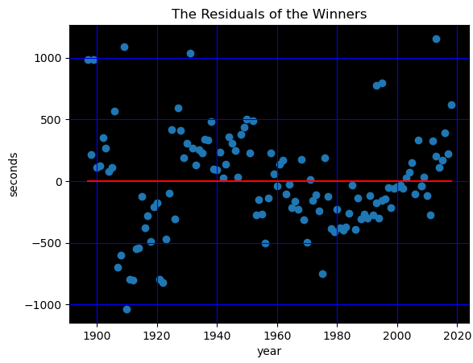
Linear Regression
Independence from obtaining yearly race winner data allows for unbiased and objective analysis of long-term performance trends in the sport.
The linearity of data points related to yearly race winners suggests a potential correlation between year and finish time.
The equal variance observed across the majority of the residuals, as indicated by the scatter plot displaying no discernible pattern, signifies a robust and consistent dispersion of the data points around the regression line.
The expected finish time in seconds is (40638.0435- 16.4023 * year)

Slide 9
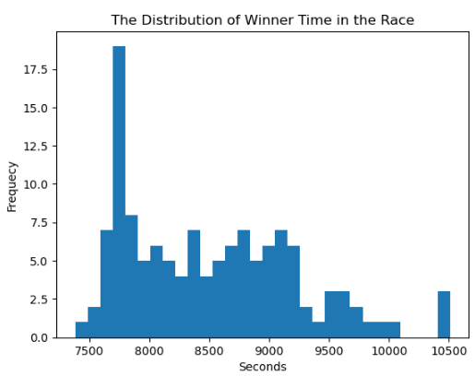
Distribution
Normally distributed residuals cause the assumption of normally distributed dataset which is not met in this dataset as the histogram of the dataset is right skewed.
Statistical Significance:
Pooled Two-sampled T-test
Test whether there was sufficient statistical evidence to reject the null hypothesis
Degrees of freedom: 127
Significance level: α = 0.05.

Slide 10
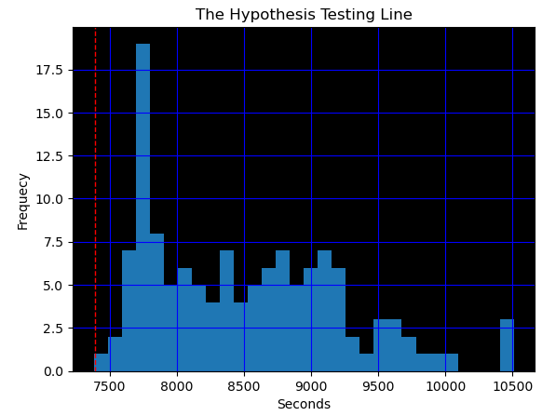
Hypothesis Testing
Null hypothesis: If long-distance races have occurred more frequently in recent history, then they was have the same finish time as runner in the past.
P-Value: 3e-28< 0.05
Based on a significance level of 0.05, we reject the null hypothesis since there is sufficient evidence that the years that you ran the race affect your finish time.

Slide 11
Implications
Modern Training Techniques
New advancements in coaching and training methods
New emphasize the role of sports science
Impact of Technology
New advanced footwear and gear
Usage of wearable tech in tracking performance

Slide 12
Conclusions
Overall, we found that marathon runner that run in the Boston Marathon between 1897- 2019 who ran in the modern era of running performed better than runner who run in a past era.
The more modern the runner = a better finish time compare to the runner of the past.

